Slide 1
Presentation to MCESD members on “The future of European competitiveness” Report by Mario Draghi & with an input analysis towards Malta’s new economic vision 06/11/2024

Slide 2
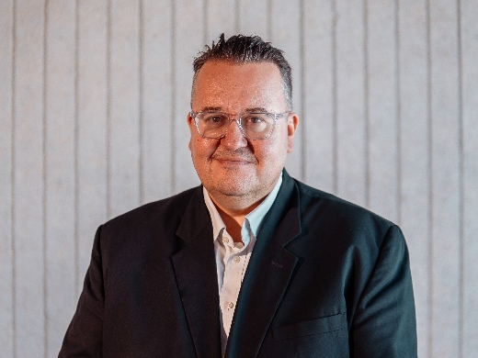
About EMCS
EMCS Advisory has a long experience in performing various Economic Analysis. EMCS (Economic Management Consultancy Services) was born primarily at being the first Economic Advisory firm in Malta. We are proud to have maintained Economic Advisory as a central part of our offering for the past 40 years. EMCS Advisory has a dedicated team of economists and consultants to ensure that the most accurate results are obtained for the client.
EMCS Consultants
STEFANO MALLIA
Partner – Advisory Services
stefano.mallia@emcs.com.mt
KURT MUSCAT
Assistant Manager – Advisory Services
kurt.muscat@emcs.com.mt
SILVAN MIFSUD
Director – Advisory Services
silvan.mifsud@emcs.com.mt
DIANE CILIA
Lead Associate – Advisory Services
diane.cilia@emcs.com.mt
1

Slide 3
Purpose of Study
Investigate and analyse the Draghi report on the Future of European Competitiveness & provide an input analysis towards Malta’s new economic vision.
EMCS will provide MCESD members with a comprehensive overview of the Draghi report, which was issued on the 9th of September 2024.
The analysis will guide the necessary discussions as to how Malta can become more competitive and aligned with the evolving direction of the European Union.
2

Slide 4
Timeframe
The study will be complete within 6 weeks
Discussion on the presentation and gather feedback from Social Partners
By Week 4
Provide a final comprehensive document that includes the main proposals of Draghi’s report, the impact to the national context and economic strategic that can be used as an input towards Malta’s latest economic vision
By Week 6
Deliver a comprehensive presentation on Draghi’s report, with a detailed impact analysis on the national policies and context
By Week 2
3

Slide 5
The deliverables
Deliverable 1: Presentation to MCESD members on “The Future of European Competitiveness” Report by Mario Draghi & detailed impact analysis on the national policies and context
The first step is to highlight the key insights & recommendations from the Draghi report, including an overview of the report’s analysis of industry challenges and opportunities within the Single Market.
Our analysis will highlight the key points & recommendations, which relates to the main sections of the report, closing the innovation gap, harmonizing decarbonization with competitiveness and enhance economic security by reducing dependencies. We will put a greater emphasis on the sections & sectors which are more important to the Maltese context.
This analysis will facilitate a deeper understanding of how the data and findings of this report & the European-wide strategies can be adopted to the Maltese context and also determine the implications on our national policies.
The Draghi Report:
The future of European Competitiveness
Part A
A competitiveness strategy for Europe
Part B
In-depth analysis and recommendations
4

Slide 6
The structure of the Draghi report
Part A
Part A
A competitiveness strategy for Europe
The starting point: a new landscape for Europe
Three transformation ahead for Europe
Towards a European Response
Preserving social inclusion
Closing the innovation gap
A joint decarbonisation and competitiveness plan
Increasing security and reducing dependencies
Financing investments
Strengthening Governance
Europe’s productivity challenge
Key barriers to innovation in Europe
The root cause of high energy prices
The threat to Europe’s clean tech sector
The challenges of asymmetric decarbonisation
A joint plan for decarbanisation and competitiveness
Reducing external vulnerabilities
Strengthening industrial capacity for defence and space
5

Slide 7
The structure of the Draghi report
Part B: Section 1
Part B
In-depth analysis and recommendations
Section 1: Sectoral policies
Energy
Critical raw materials
Digitalisation and advanced technologies
High-speed/capacity broadband networks
Computing and AI
Semiconductors
Energy-intensive industries
Clean technologies
Automotive
Defence
Space
Pharma
Transport
6

Slide 8
The structure of the Draghi report
Part B: Section 2
Accelerating innovation
Closing the skills gap
Sustaining investment
Revamping competition
Strengthening governance
Refocusing the work of the EU
Accelerating the work of the EU
Simplifying rules
Part B In-depth analysis and recommendations
Section 2: Horizontal policies
7

Slide 9
The deliverables
Deliverable 2: Gather feedback from social partners during the discussion following the presentation
Following the presentation, an open forum will be held for MCESD members, including social partners, to discuss the implications of the report’s findings.
This feedback will ensure that the national response to the Draghi report is grounded in the present realities of Malta’s economic and social landscape, to provide a good understanding of the present gaps to move ahead towards the targets outlined in Draghi’s report.
Finally, we will also allow a few days for social partners to review the presentation done and to come back with further feedback.
8

Slide 10
The deliverables
Deliverable 3: Consolidate feedback received into a document that will serve as a base to eventually set up a coherent economic vision & strategy
The final step is to put together a report which will use the discussion at MCESD as an input towards Malta’s new economic vision just recently launched by the Malta Government.
The document will be concise to avoid long and winding explanations. It will highlight the view of the social partners towards shaping Malta’s economic strategy which is aligned with the European Union’s broader vision as outlined in the Draghi report.
The document will serve as a crucial tool in guiding future policy decisions and reforms, ensuring that Malta takes a proactive approach in addressing the challenges and opportunities as outlined in Europe’s evolving economic landscape.
9

Slide 11
EMCS Advisory
with compliments
Centris Business Gateway II, Level 4
Triq is-Salib tal-Imriehel Zone 3
Central Business District
Birkirkara, CBD3020, Malta
T +356 2777 2777
E info@emcs.com.mt
W www.emcs.com.mt
10

